Slide 1
Newsletter Data Tutorial
Ilana Seidl

Slide 2
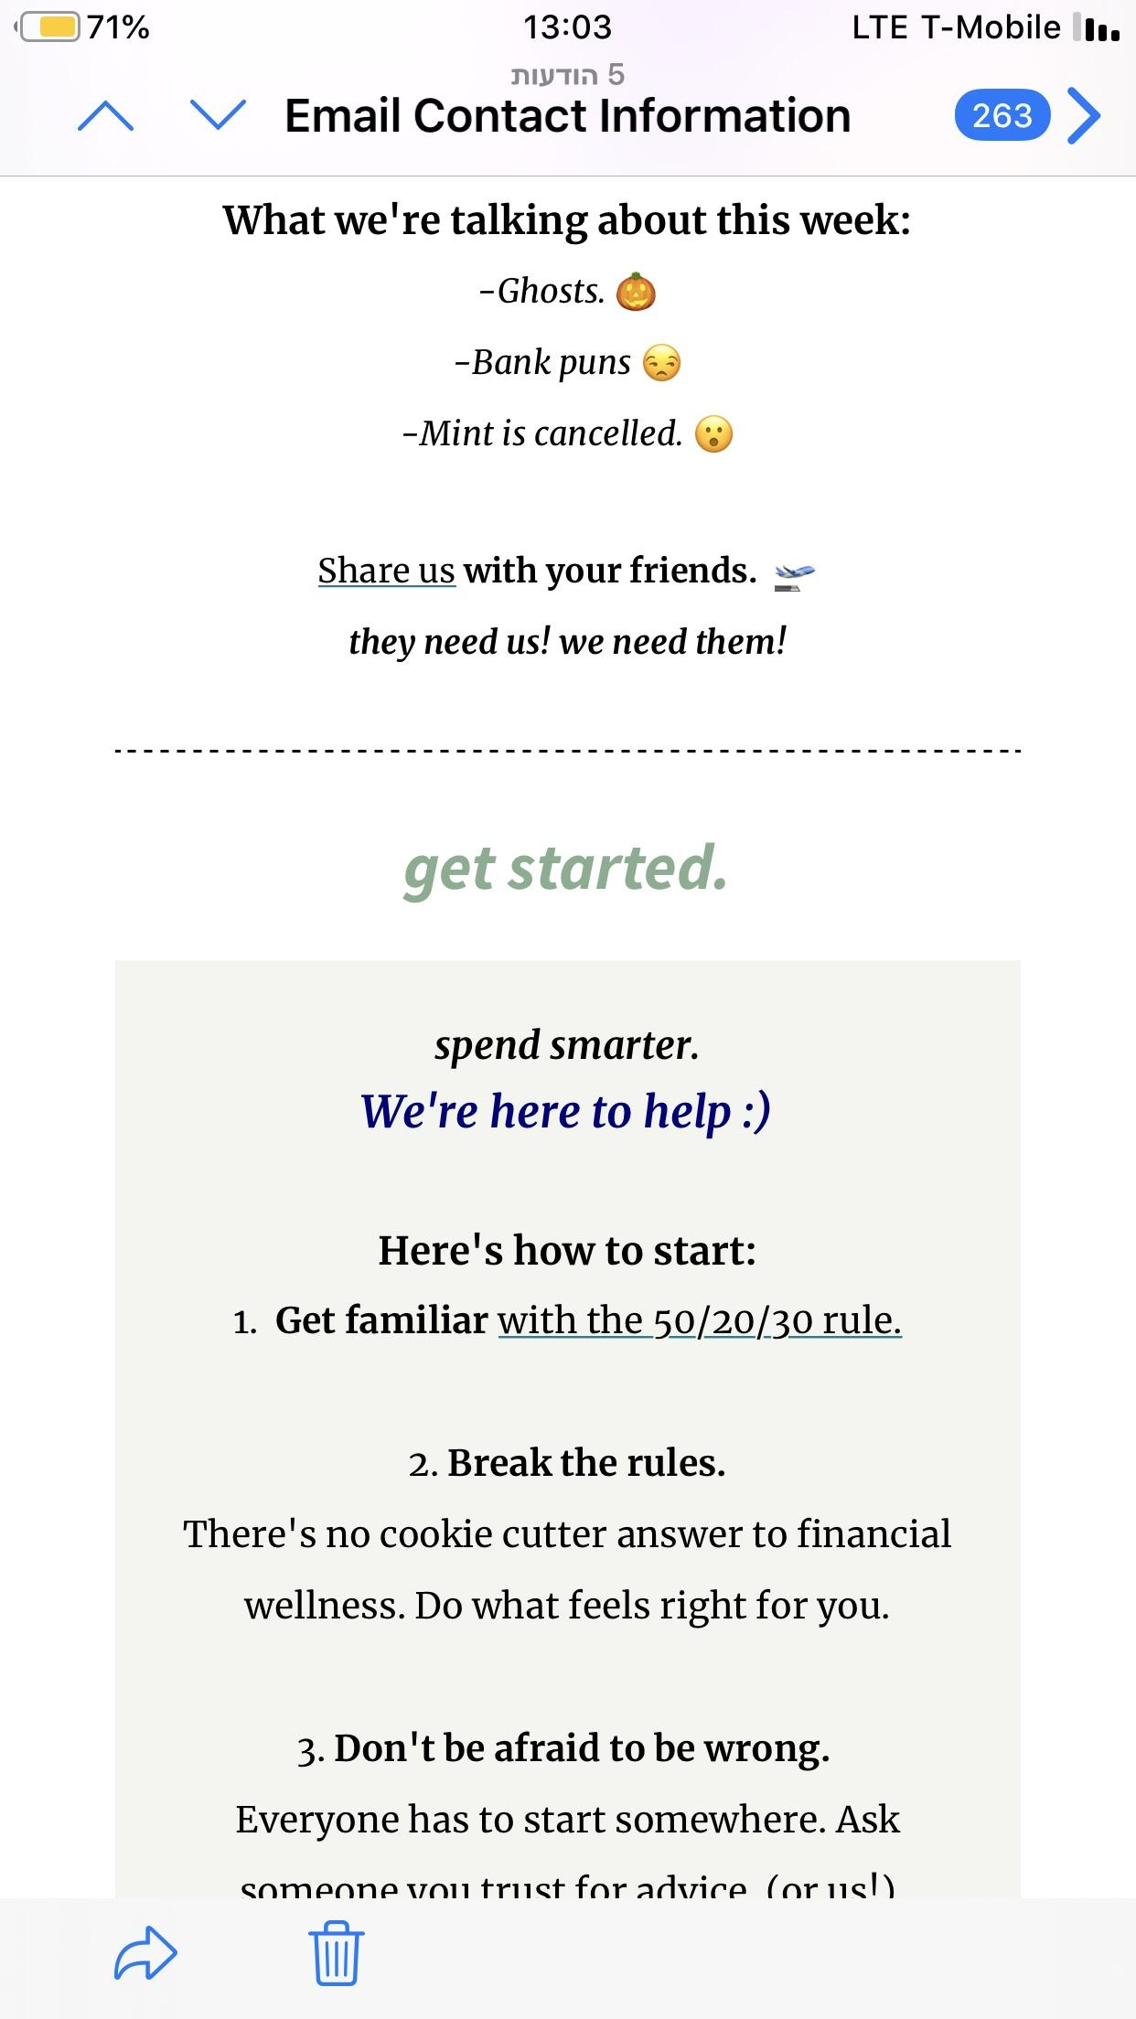
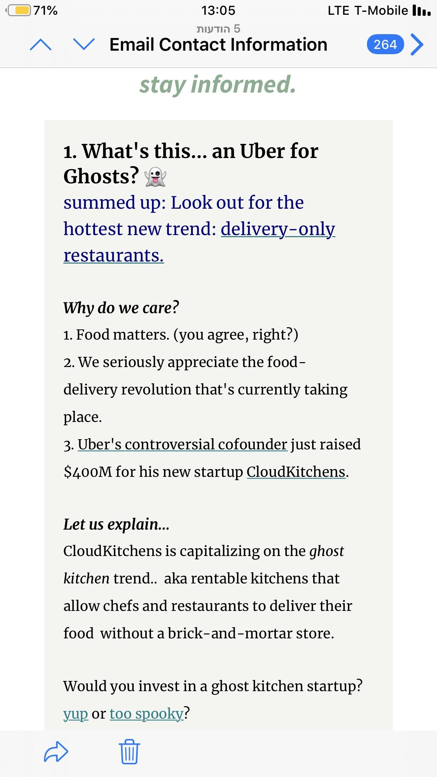
Problem
Weekly effort to send out newsletter without clear understanding of impact
Need control over data in order to accurately measure growth and plan for the future
Need specific newsletter metrics to present to investors, judges, and potential partners or advertisers

Slide 3
Overview
Data Collection
Downloadable CSVs from Mailchimp
Loading and preprocessing
Main concern: anonymizing data
Tidying data
Exploratory Analysis
Subscriber data
Campaign data
Hypothesis
Hour is the most important factor in a successful email
Conclusion
Hour has the lowest correlation to Unique Opens and Total Opens, arguably our most important metrics

Slide 4
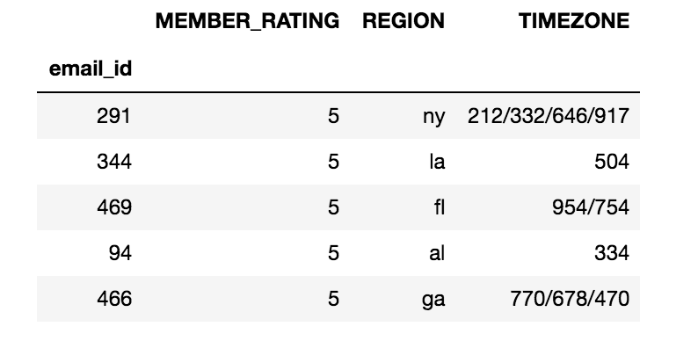
Subscriber data
Anonymized by shuffling index and adding email_id
Subscriber metrics
MEMBER_RATING
Mailchimp determines rating based on engagement
REGION and TIMEZONE
Helpful for optimizing sendtimes

Slide 5
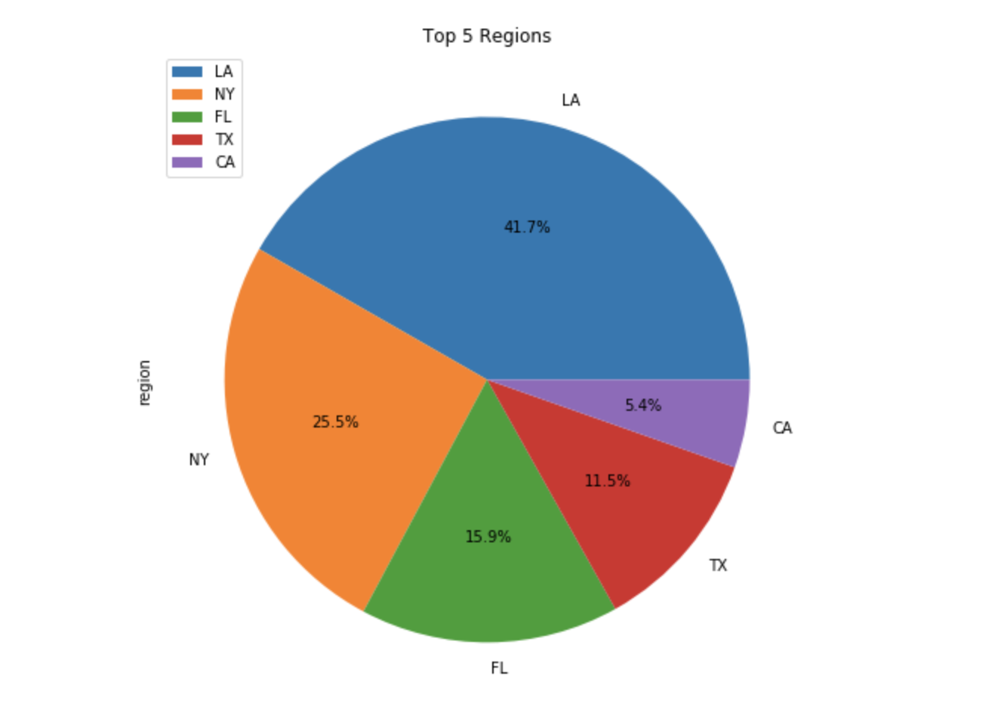
Subscriber Observations

Slide 6
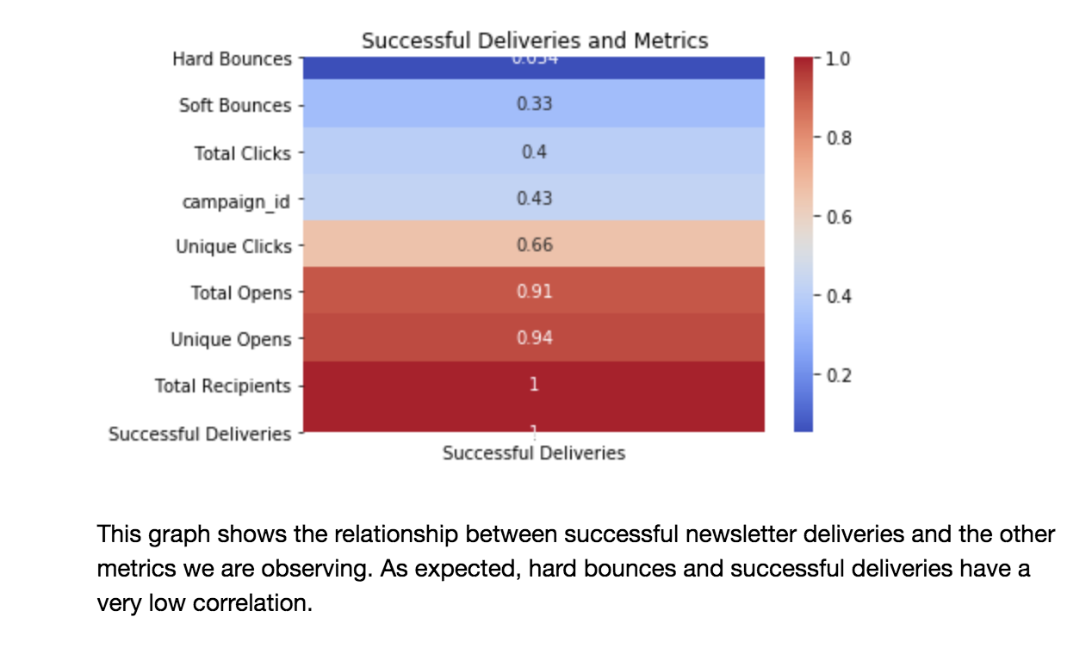
Campaign Observations: Successful Deliveries

Slide 7
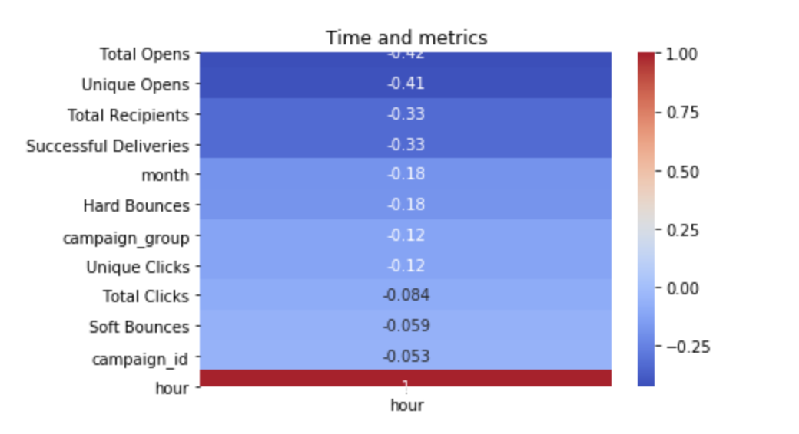
Campaign Observations: Hour

Slide 8
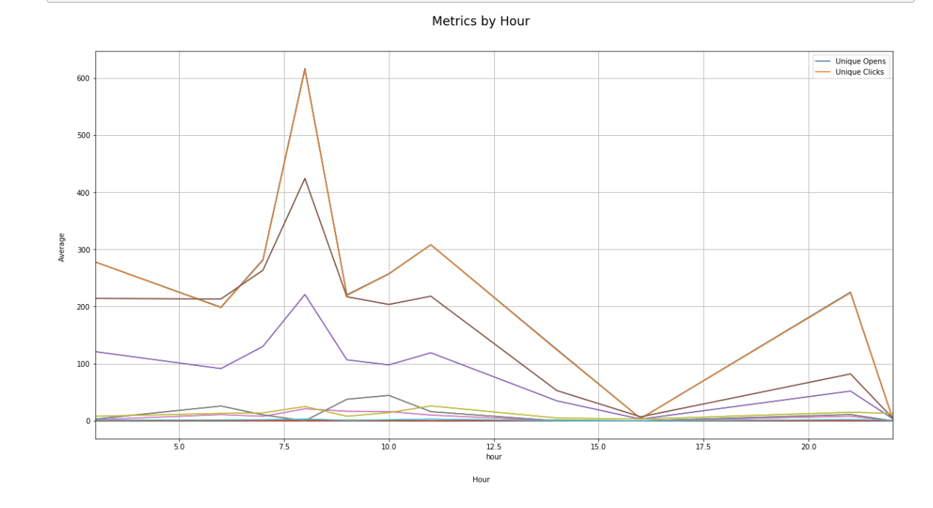
Campaign Observations: Hour

Slide 9
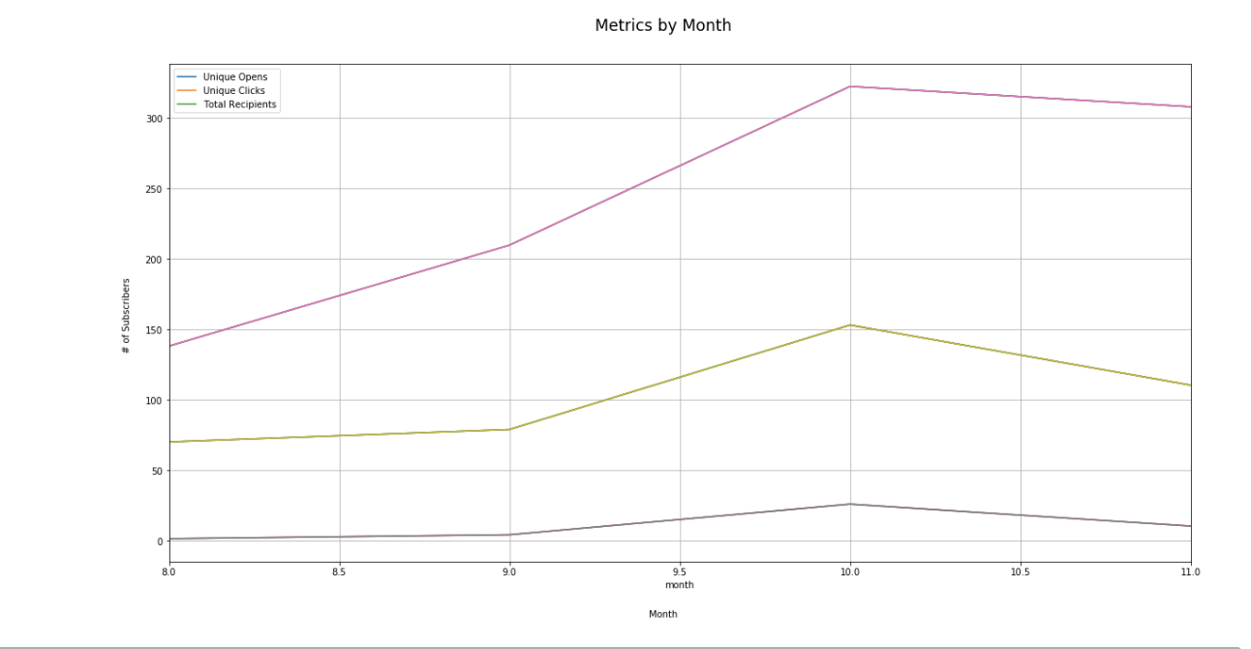
Campaign Observations: Month

Slide 10
Conclusion
Time is an important factor in email metrics
Action: Send emails out between 5 AM and 10 AM
Factor in majority region time zones
Continue gathering data → more data means more concrete findings
Future plans
Continue looking into Subscriber data and see what other factors can be analyzed
Make predictions for future growth using ML and Sci-kit learn (especially useful for investors and competitions)

